Slide 1

Frac Visualization Solution
December 01, 2017

Slide 2
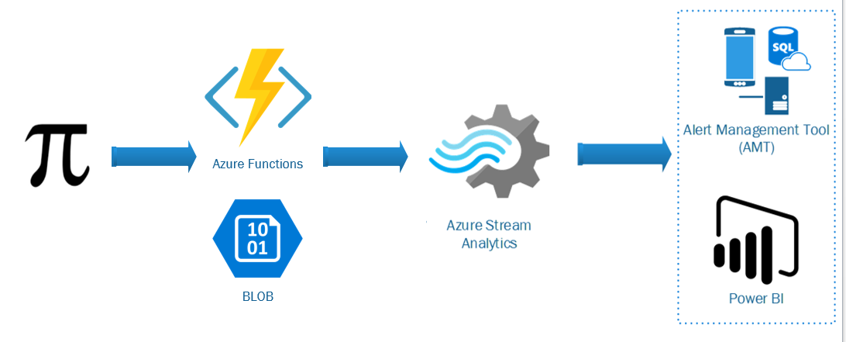
Solution
Notes:
Current state
Pi Data Collection via
Azure Function
Timer to collect data at defined interval - 5sec
Stored into Blob Storage for
Stream Analytics
Query ability to filter, sort, aggregate, and join streaming data over a time period
Alert Manager Tool (AMT) - User interface to create, manage, and set notification method of alerts.
Alert Analytics - PowerBI Dashboard to analyze\manage PIC performance as related Alerts, Alert Templates and alert metrics, e.g. time to acknowledge, time to resolve

Slide 3
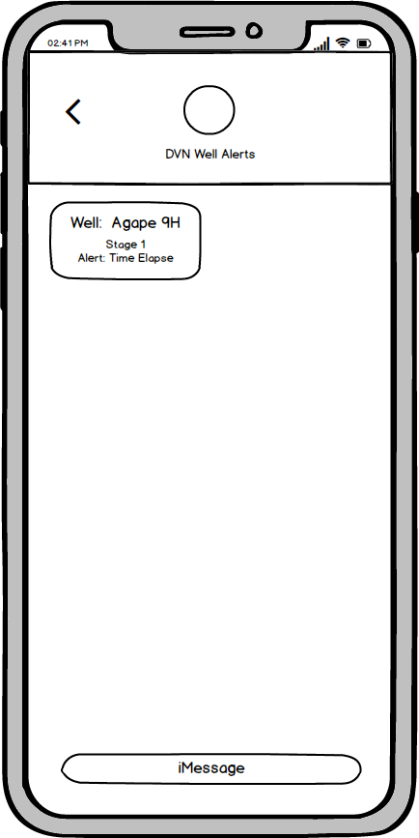
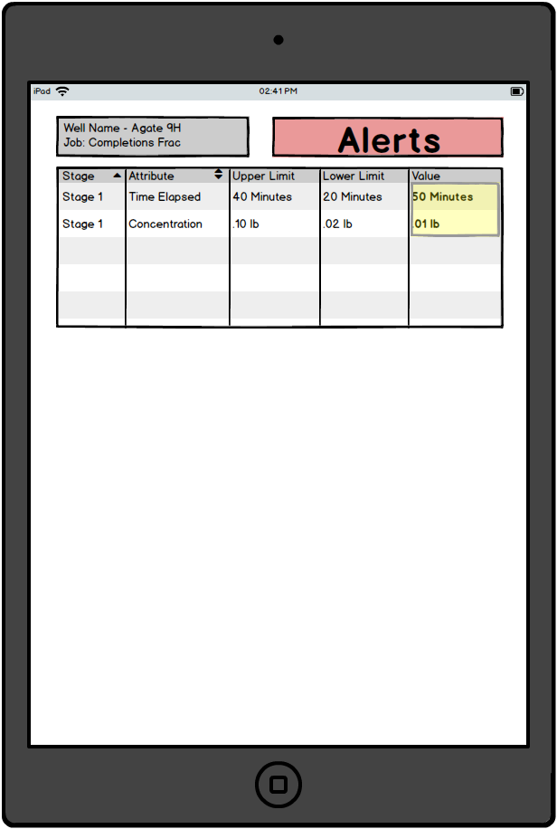
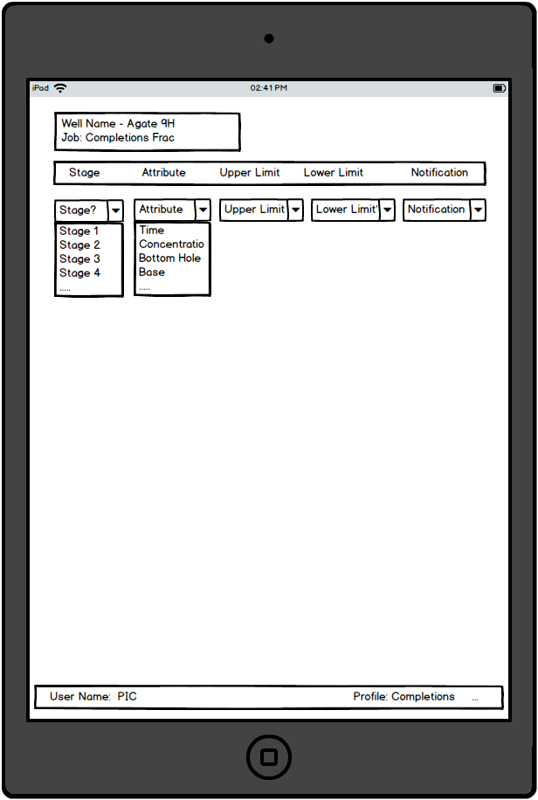
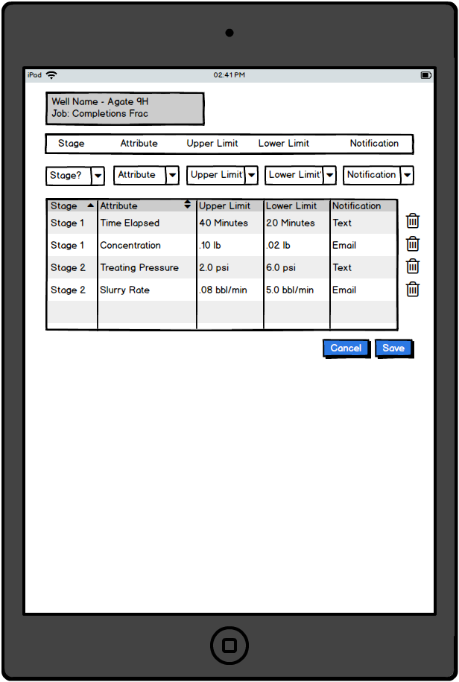
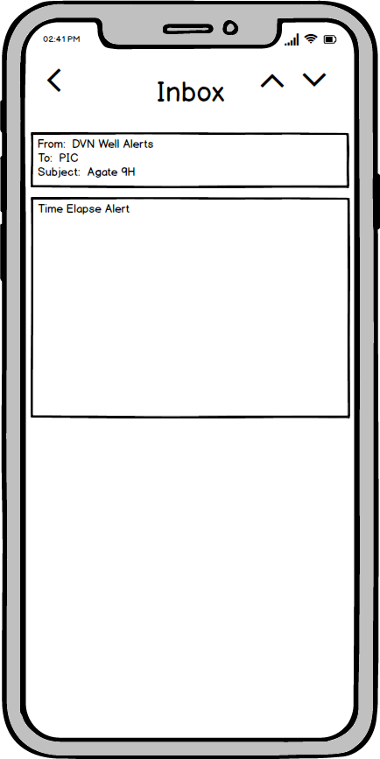
Alert Management Tool (AMT)
Alert creation by Engineers and PIC
Alert Templates
Alert Monitoring
Alert custom notifications
SMS
Email
Notes:
Alert creation by Event Frame \ Stage – not all alerts are applicable during the full frac job
Alert Creation
Engineer will create alerts
Engineer alerts can’t be updated by the PIC
PIC can create additional alerts relevant to him
Templates
Templates by Well or other criteria can be saved
Examples – Well Types, Production Methods etc
Saved and applied to other Jobs
Future State – End of well analysis can be done
Missed alerts
Events that were not caught
Incorporate those findings back into Templates
Alert Notification
Show current alerts based on wells
Mobile Notification
Email
Text
Frequency – can be customizable
Will allow alerts to go out until event has stopped
One time alerts
Acknowledgment

Slide 4
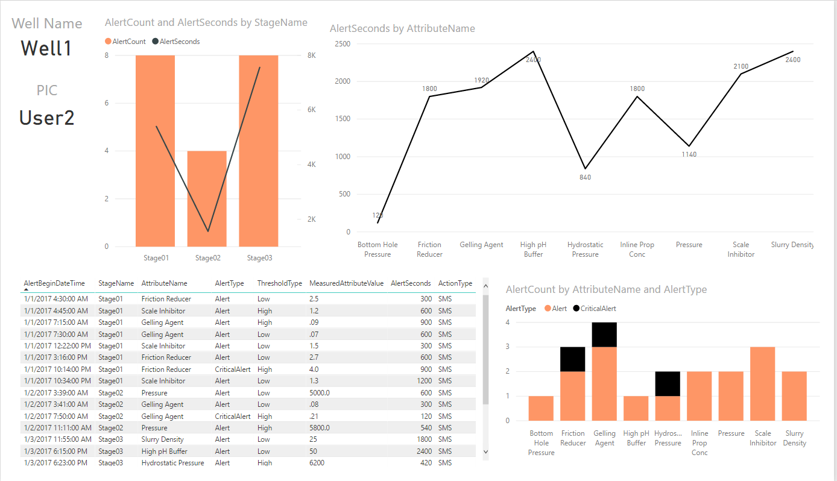
PowerBI Alert Analytics
Notes:
Alert Analytic Examples
Alert Count by Stage(Event Frame)
Alert Seconds Duration
Raw Data
Alert Count by Type

Slide 5
Extended Solution
Notes:
Future State Potential
Azure Machine Language
Leverage historical PI data to capture failures and leverage alerts to predict failures
Efficacy analysis
What if
IoT - add devices to receive alerts and take action to connect and control sensors and equipment at for both Drilling and Operations
BOT Frame work
As alerting and actions matures bots can help provide a communication channel to Teams throughout the company

Slide 6
Q&A

